Slide 2

Applied Algorithm Lab
Strongly connected component

Slide 3
Strongly connected component
Count #strongly connected components in a directed graph
Definition: A subset with maximal number of vertices that between 2 arbitrary vertices, there exists a path from a vertex to the other and vice versa.
Thành phần liên thông mạnh là một tập con tối đa các đỉnh sao cho giữa 2 đỉnh bất kỳ luôn có đường đi từ đỉnh này đến đỉnh kia và ngược lại.
Input: Edge list
Line 1 contains N, M
M lines follow, containing a pair of 2 integers a, b which is an undirected edge from a to b.
Output:
Number of strongly connected components.

Slide 4
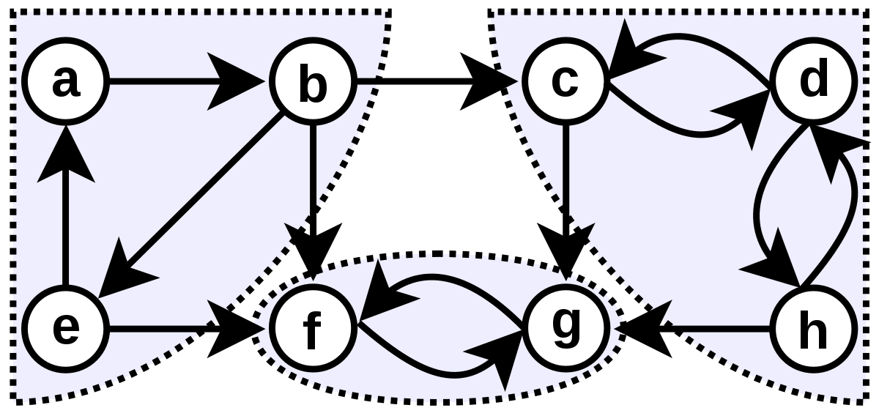
Strongly Connected Components
BFS and DFS can find all connected component in undirected graph.
However, in directed graph, finding all strongly connected components is not trivial.
Can we use DFS tree to find all strongly connected components ?

Slide 5
Strongly connected component
Idea to solve: DFS on residual graph. Algorithm:
Run DFS on G -> compute the finishing time f(v) of each node v of G
Build residual graph G^{T} of G: reverse direction of all edges
Run DFS on G^{T}:
the nodes are considered in a decreasing order of finishing time f:
Each run DFS(u) will visit all nodes of the strongly connected component containing u
Number of connected components on G = number of times call DFS on residual graph of G

Slide 6
THANK YOU !

